Slide 1
Replication of Partial Least Squares Discriminant Analysis on Metabolomics NMR/MS Data
Florencia Marcaccio
Sanjana Gupta
Medha Sagar
Adrian Tullock
Faryal Usman
Publication Link: https://www.ncbi.nlm.nih.gov/pmc/articles/PMC2703878/
Repository: https://github.com/UW-MSDS-DATA-598-Reproducibility-WI20/gupta-marcaccio-sagar-tullock-usman-replication-project

Slide 2
Introduction
The purpose of our paper is to serve as the home of the replication project for the metabolomics analysis
Metabolomics is the scientific study of chemical processes involving metabolites, the small molecule substrates, intermediates and products of metabolism.
There are a number of data processing challenges germane to metabolomics
These processes include metabolomic data processing, normalization, multivariate statistical analysis, and data annotation

Slide 3

Target Paper - MetaboAnalyst: a web server for matabolomic data analysis and interpretation
Web-based tool for metabolomics studies.
Accepts a variety of input data.
Four modules:
Data processing
Statistical analysis
Functional enrichment analysis
Metabolic pathway analysis
Notes:
MetaboAnalyst is a comprehensive, web-based tool designed to facilitate high-throughput metabolomics studies.
It accepts a variety of input data (NMR peak lists, binned NMR or MS spectra, MS peak lists, compound/concentration data) in a wide variety of formats.
It also offers a number of options for metabolomic data processing, data normalization, multivariate statistical analysis, graphing, metabolite identification and pathway mapping.

Slide 4
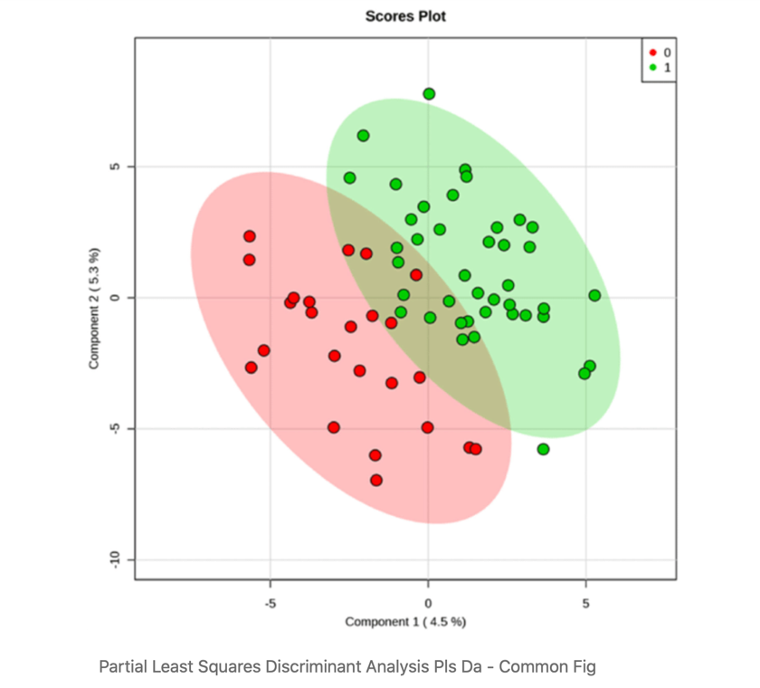
Partial Least Square Discriminant Analysis
Data used in the Metabolomics field:
Highly correlated
High-dimensional
Few observations
No knowledge of underlying distribution
Traditional linear methods fail, so PLS-DA and PCA are used instead
Notes:
This would be the scientific claim that we focused on in the replication.
Metabolomics is a field that studies metabolic changes in biological contexts by analyzing various methods (for example liquid gas chromatography etc) to narrow down on changes caused at the molecular level
Such data, a good example of which is spectral NMR data, is usually high dimensional and split into micro-arrays
Principal Component Analysis. PCA takes a matrix X of predictor variables as an input and performs dimension reduction by calculating linear combinations of features to summarize data without losing critical information. Its advantages include:
Working with highly correlated data
Working with a small number of observations
Not making any distribution assumptions beforehand
Info from deleted next slide:
For example if a researcher has two samples of data from seemingly healthy and unhealthy patients and wants to classify patients algorithmically.
Partial Least Squares interprets variance between predictor variables X as well as the relationship of X to the qualitative / categorical target variable Y

Slide 5
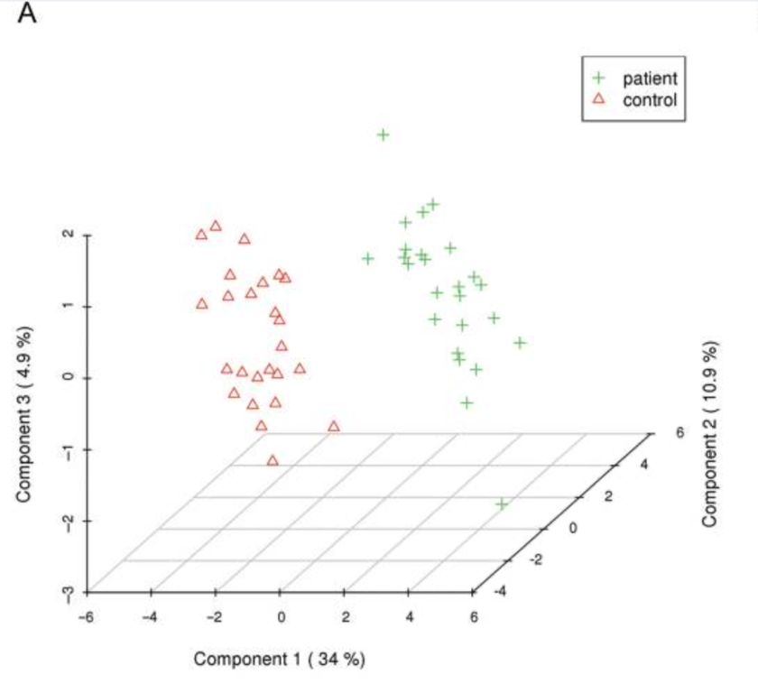
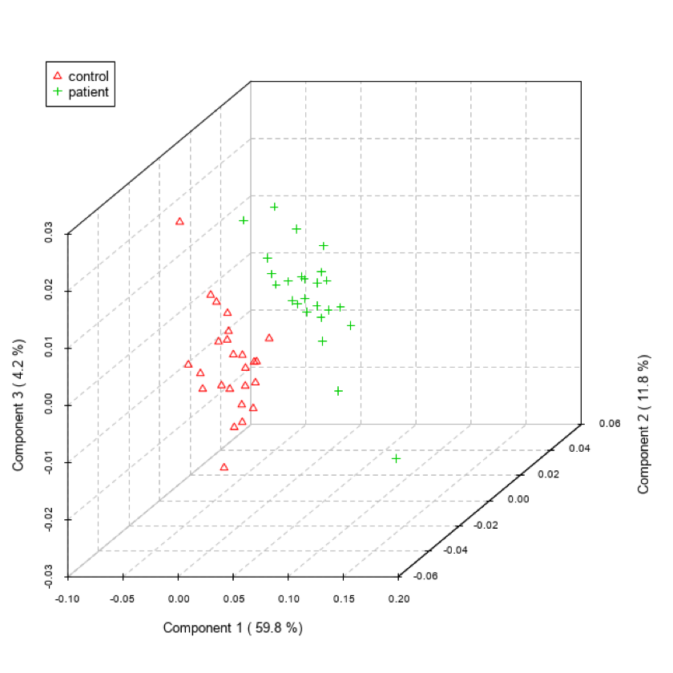
Partial Least Square Discriminant Analysis
Target figure
Obtained figure

Slide 6
Technical Variations
Imputation method of missing values
Filtering method of unused variables
Component for variable importance
Did not make a difference due to already clean data
Notes:
Add something to explain the first two, but not much.
The package also generates feature importance graphs along with the PLSDA analysis. The feature importance function also takes into account, the component on which it calculates the importance
You can change the 'component' parameter and compare how the feature importance changes from one component to another.

Slide 7
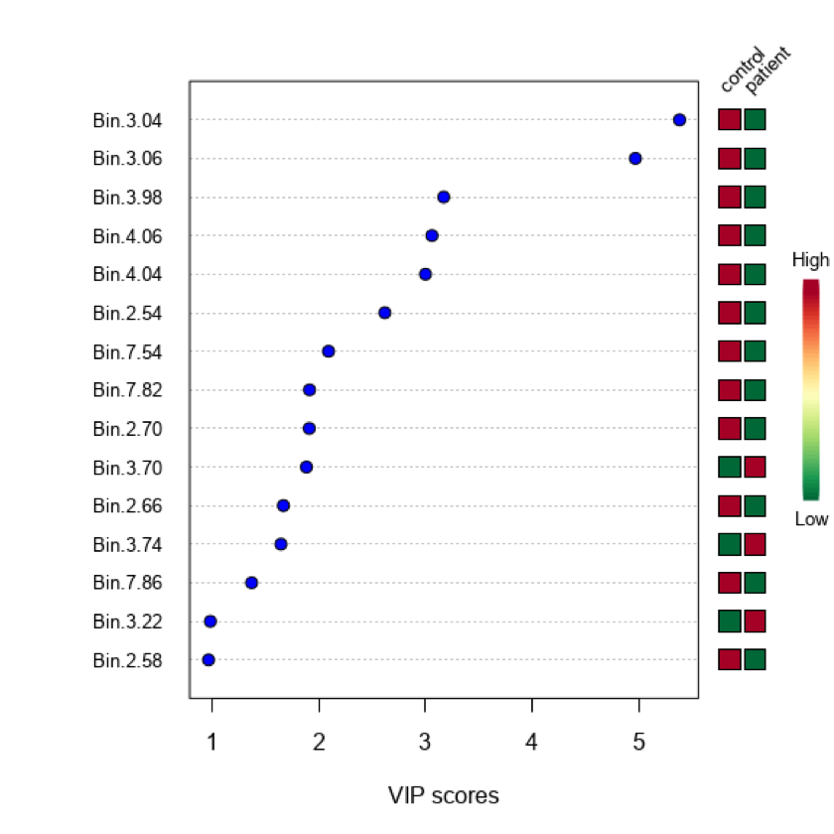
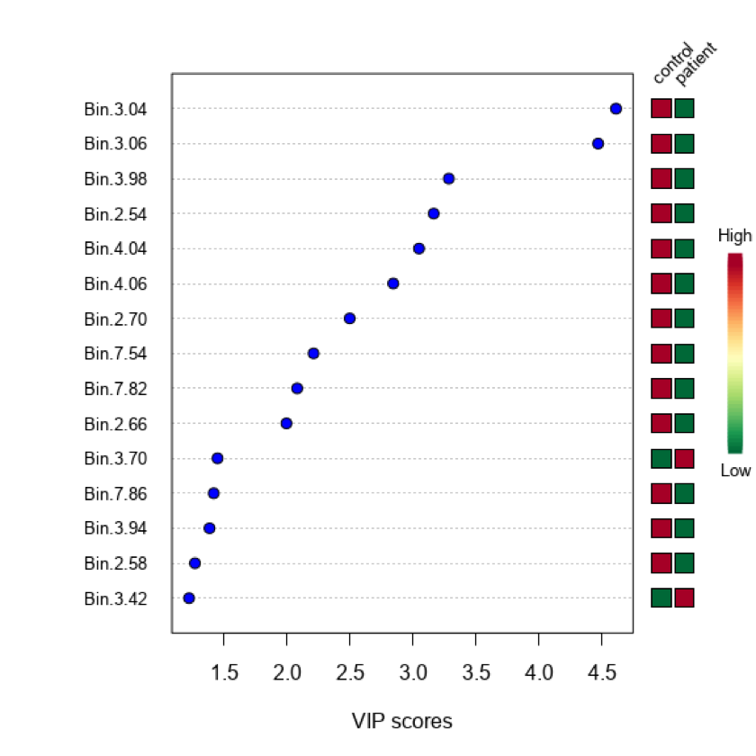
Technical Variations: Component for variable importance

Slide 8
Challenges
Domain Knowledge
Technical
Theoretical
- Problems installing MetaboAnalyst package.
- Re-defining the native data types to the package is not possible.
Not enough information on data processing methods used in the original paper.
Not many packages produce reliable PLSDA score plots.
We unsuccessfully tried the following packages:
DiscriMiner
GGPlot2 PCA
PLSDA
mdatools
Install CAMERA through BioConductor manually
Install XQuartz for compatibility with the Cairo package
While we tried different combinations, our replicated figure is similar but not exactly the same as target figure.
Notes:
Domain Knowledge:
PLSDA and PLSDA scores plot are produced done reliably through very few packages. Examples of packages that we attempted to use but were unsuccessful with are:
DiscriMiner
GGPlot2 PCA
PLSDA
mdatools
Technical:
As MetaboAnalyst is a highly complicated package we came across some problems installing the package. Some variations that we implemented that were not suggested by the authors are:
Install CAMERA through BioConductor manually
Install XQuartz for compatibility with the Cairo package
Re-defining the native data types to the package is not possible. I.e. if you process a dataset as input to MetaboAnalyst, you might have trouble doing it again.
Theoretical:
We found some of the data processing instructions such as normalization etc. in the original paper to be vague (it was authored in 2009). Thus our example is similar to the authors example but is not exact.

Slide 9
Conclusions
We experienced some difficulties when installing the package.
The processing steps are not detailed enough in the original paper.
While we were able to replicate the figure in the target paper, there are noticeable changes between both figures. We believe that this is due to some outlier removal technique not mentioned in the paper.
Notes:
Having said that, there are some noticeable changes between the two figures. 1. The principal component 1 have different values. 2. The scale for both axes are different 3. More points in the replicated figure
We believe that the original analysis had implemented some outlier removal technique. It would explain the difference in the first component, and why we get more outliers.

